Slide 1
Encipherment Using
Modern Symmetric-Key Ciphers
Dr. B C Dhara
Department of Information Technology
Jadavpur University

Slide 2
Objectives
How modern standard ciphers, such as DES or AES, can be used to encipher long messages
Discuss five modes of operation in modern block ciphers
Which mode of operation creates stream ciphers out of the underlying block ciphers
Discuss the security issues and the error propagation of different modes of operation
Discuss two stream ciphers used for real-time
processing of data
B C Dhara, Dept. of IT, JU

Slide 3
USE OF MODERN BLOCK CIPHERS
Symmetric-key encipherment can be done using modern block ciphers
Modern ciphers like DES and AES are designed to encipher and decipher a block of text of fixed size
A text to be enciphered is of variable size
Modes of operations have been devised to encipher text of any size employing DES or AES
Topics to be discussed
Electronic Codebook (ECB) Mode Cipher Block Chaining (CBC) Mode
Cipher Feedback (CFB) Mode Output Feedback (OFB) Mode
Counter (CTR) Mode
B C Dhara, Dept. of IT, JU

Slide 4

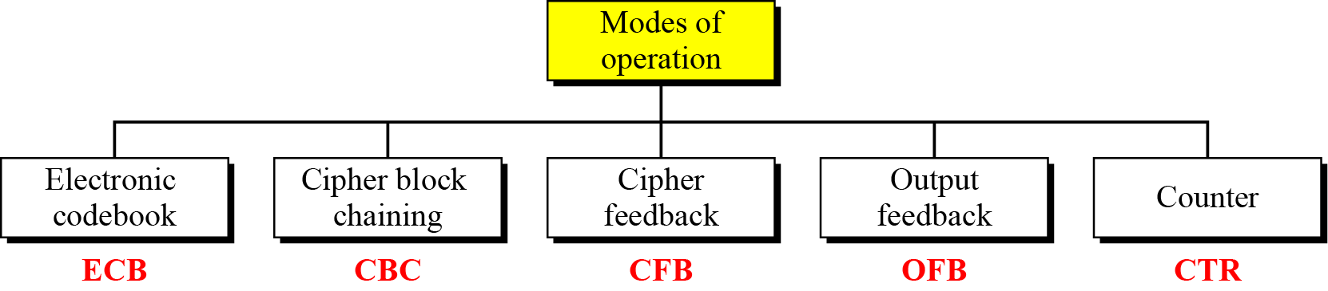
Modes of operation
B C Dhara, Dept. of IT, JU

Slide 5
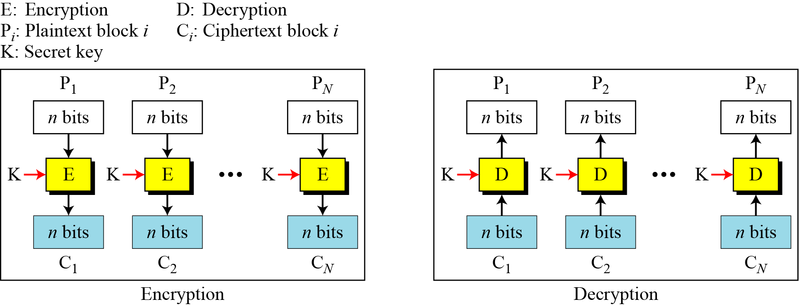
Electronic Codebook (ECB) Mode
This is the simplest mode
The plaintext is divided into N blocks
  Block size is n bits; ➔ total size of text is N*n bits
  If needed then text padding is used
The same key is used to encrypt and decrypt each block
B C Dhara, Dept. of IT, JU

Slide 6


Electronic Codebook (ECB) Mode (contd…)
  Same plaintext value will always result in the same ciphertext value
ECB can leave plaintext data patterns in the ciphertext
a bitmap image which uses large areas of uniform color
Security can be improved by inclusion of random padding bits in each block
B C Dhara, Dept. of IT, JU

Slide 7
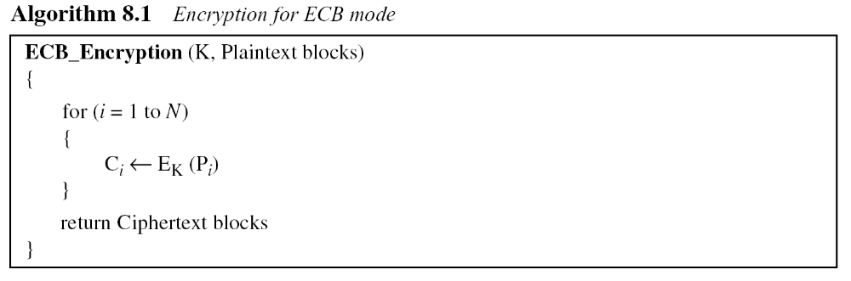
Pseudocode for ECB mode
Block independency creates opportunities to exchange some ciphertext blocks without knowing the key.
B C Dhara, Dept. of IT, JU

Slide 8
Error Propagation
A single bit error in transmission can create errors in several in the corresponding block. However, the error does not have any effect on the other blocks
B C Dhara, Dept. of IT, JU

Slide 9
Ciphertext Stealing
Padding added (if required) to the last block
  The size of the ciphertext would be greater size, disadvantage
Ciphertext stealing is a technique for encrypting plaintext using a block cipher, without padding the message to a multiple of the block size, so the ciphertext is the same size as the plaintext
B C Dhara, Dept. of IT, JU

Slide 10
Ciphertext Stealing (contd…)
The processing of all but the last two blocks is unchanged
Change the processing of the last two blocks of the message
A portion of the second-last block's ciphertext is "stolen" to pad the last plaintext block
The padded final block is then encrypted as usual.
B C Dhara, Dept. of IT, JU

Slide 11
Ciphertext Stealing (contd…)
The final ciphertext consists
  Ciphertext of all blocks but last two blocks
  For the last two blocks,
    The partial penultimate block (with the "stolen" portion omitted) plus the full final block
The size of the ciphertext is same size as the original plaintext
Decryption requires decrypting the final block first
  then restoring the stolen ciphertext to the penultimate block, which can then be decrypted as usual
B C Dhara, Dept. of IT, JU

Slide 12
This step describes how to handle the last two blocks called P_{n−1} and P_{n}, of the plaintext and generates two ciphertext C_{n−1} and C_{n}
  The length of P_{n−1} equals the block size of the cipher in bits, B
  The length of the last block, P_{n}, is M bits
  K is the key that is in use
  M can range from 1 to B, inclusive, so P_{n} could possibly be a complete block
B C Dhara, Dept. of IT, JU

Slide 13
Following functions and operators are used:
  Head (data, a): returns the first a bits of the 'data' string
  Tail (data, a): returns the last a bits of the 'data' string
  Encrypt (K, data): use the underlying block cipher in encrypt mode on the 'data' string using the key K
  Decrypt (K, data): use the underlying block cipher in decrypt mode on the 'data' string using the key K
  XOR: Bitwise Exclusive-OR
  ||: Concatenation operator
  0ª: a string of a 0 bits
B C Dhara, Dept. of IT, JU

Slide 14
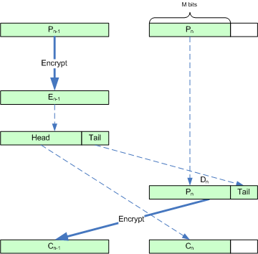
Ciphertext Stealing in ECB
Ciphertext stealing for ECB mode requires the plaintext to be longer than one block
ECB encryption steps
E_{n−1} = Encrypt (K, P_{n−1})
C_{n} = Head (E_{n−1}, M). Select the first M bits of E_{n−1} to create C_{n}
D_{n} = P_{n} || Tail (E_{n−1}, B−M). Pad P_{n} with the low order bits from E_{n−1}.
C_{n−1} = Encrypt (K, D_{n}), Encrypt D_{n} to create C_{n−1}
  The first M bits, this is equivalent to what happen in ECB mode
  The last B−M bits, this is the second time that these data have been encrypted under this key (It was already encrypted in the production of E_{n−1} in step 2).
B C Dhara, Dept. of IT, JU

Slide 15
Ciphertext Stealing in ECB (contd…)
Decryption
Error propagation:
D_{n} = Decrypt (K, C_{n−1})
E_{n−1} = C_{n} || Tail (D_{n}, B−M). Pad C_{n} with the extracted ciphertext in the tail end of D_{n}
P_{n} = Head (D_{n}, M). Select the first M bits of D_{n} to create P_{n}
P_{n−1} = Decrypt (K, E_{n−1}), Decrypt E_{n−1} to create P_{n−1}
In ECB a bit error in transmission has no effect on other block
A bit error in the transmission of C_{n−1} would result in the block-wide corruption of both P_{n−1} and P_{n}
A bit error in the transmission of C_{n} would result in the block-wide corruption of P_{n−1}.
B C Dhara, Dept. of IT, JU

Slide 16
Applications of ECB
Use of ECB is not recommended if the message length is more than one block
Area where independency of the ciphertext block is useful like, database application, where records need to be encrypted before stored or decrypted before retrieved
Parallel processing possible
B C Dhara, Dept. of IT, JU

Slide 17
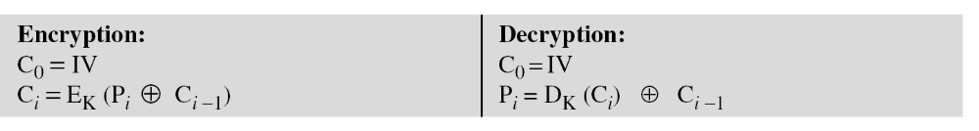
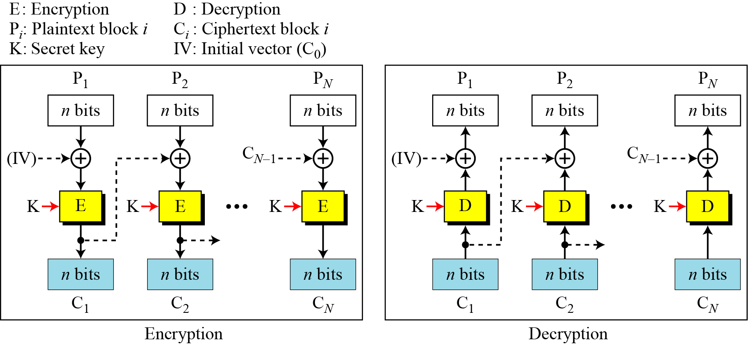
Cipher block chaining mode (CBC)
In CBC mode, each plaintext block is XOR-ed with the previous ciphertext block before being encrypted
For first block, there is a initialization vector (IV)
  The sender and receiver agree upon a specific predetermined IV
B C Dhara, Dept. of IT, JU

Slide 18
CBC mode
It can be proved that each plaintext block is recovered exactly
  Because encryption and decryption are inverses of each other
The initialization vector (IV) should be known by the sender and the receiver
  Keeping the vector as secret is not necessary
    It should be kept safe from change
B C Dhara, Dept. of IT, JU

Slide 19
Security issues
Exactly same plaintext block within same message are enciphered into different ciphertext blocks
  The patterns at block level is not preserved
  If two messages are equal and their ciphertexts are also same only when their IV are same
B C Dhara, Dept. of IT, JU

Slide 20
Error Propagation
In CBC mode, a single bit error in ciphertext block C_{j} during transmission may create error in most bits in plaintext block P_{j} during decryption
Single bit error in P_{j+1} (the bit at the same location)
P_{j+2} to P_{N} are not affected by this single bit error
B C Dhara, Dept. of IT, JU

Slide 21
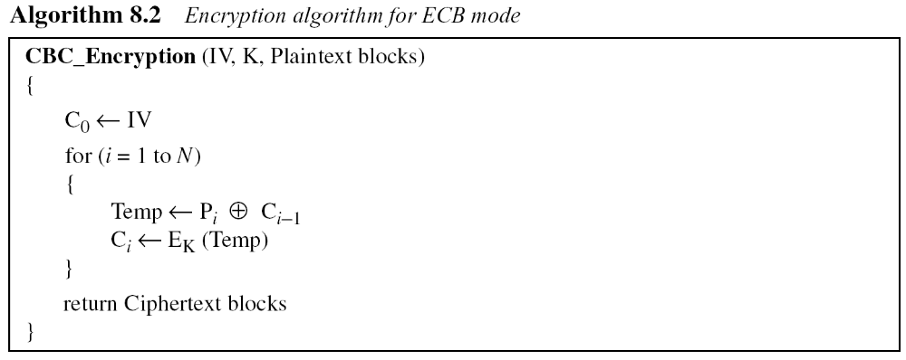
Pseudocode for CBC mode
B C Dhara, Dept. of IT, JU

Slide 22
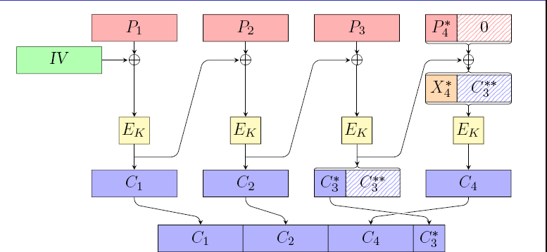
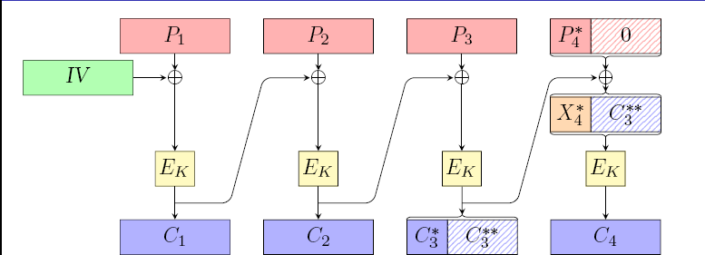
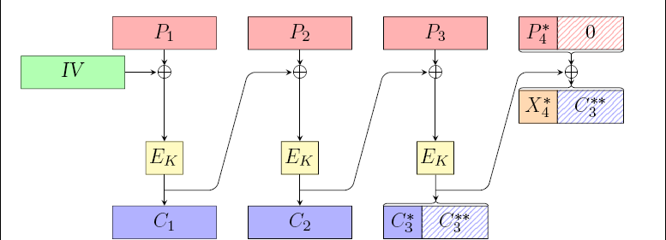
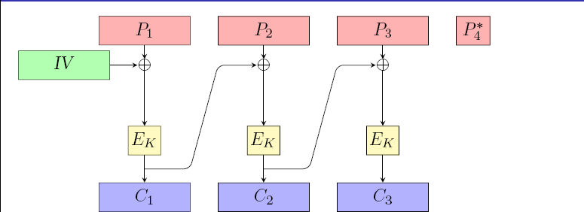
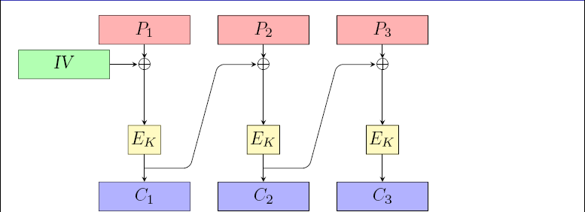
Ciphertext Stealing
X_{n−1} = P_{n−1} XOR C_{n−2} // the behavior of standard CBC mode
E_{n−1} = Encrypt (K, X_{n−1}). //the behavior of standard CBC mode
C_{n} = Head (E_{n−1}, M)// Select the first M bits of E_{n−1} to create C_{n}
P = P_{n} || 0^{B−M} //Pad P_{n} with zeros to create P of length B
D_{n} = E_{n−1} XOR P
C_{n−1} = Encrypt (K, D_{n})
B C Dhara, Dept. of IT, JU

Slide 23
Applications of CBC mode
CBC mode can be used to encipher messages
Due to chaining mechanism, parallel processing is not possible
Cannot be used to encrypt or decrypt random access files
B C Dhara, Dept. of IT, JU

Slide 24
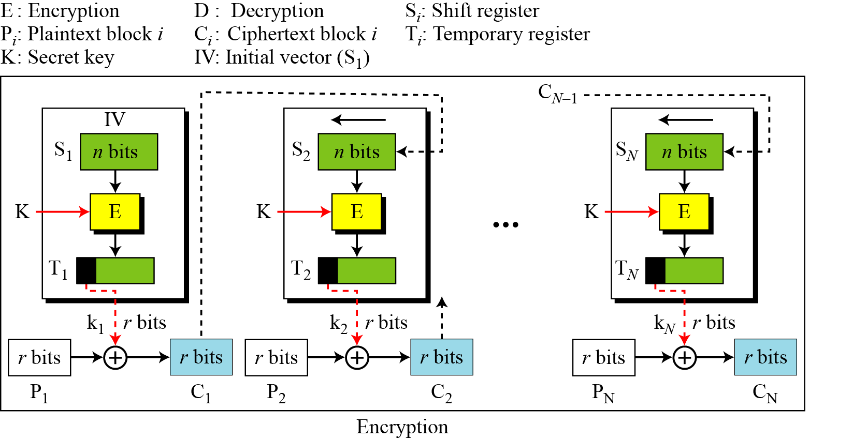
Cipher Feedback (CFB) Mode
In some situations, we need to use DES or AES as secure ciphers, but the plaintext or ciphertext block sizes are to be smaller
Use of DES or AES with smaller size can be achieved through cipher feedback (CFB) mode
B C Dhara, Dept. of IT, JU

Slide 25
Cipher Feedback (CFB) Mode (contd…)
No padding is required because the size of the block, r, is normally chosen to fit the data unit to be encrypted
CFB is less efficient than CBC or ECB
  As it applied encryption function for small block size
B C Dhara, Dept. of IT, JU

Slide 26
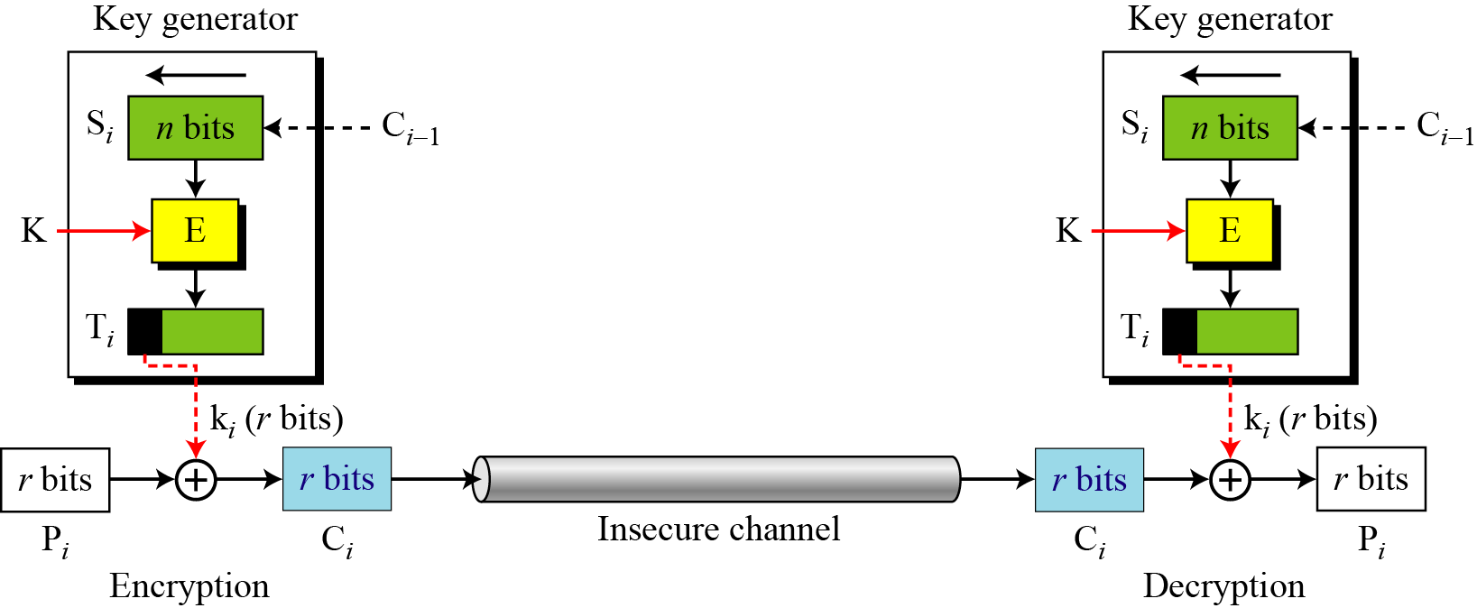
CFB as a Stream Cipher
This is non-synchronous stream cipher, key stream dependent on ciphertext
B C Dhara, Dept. of IT, JU

Slide 27
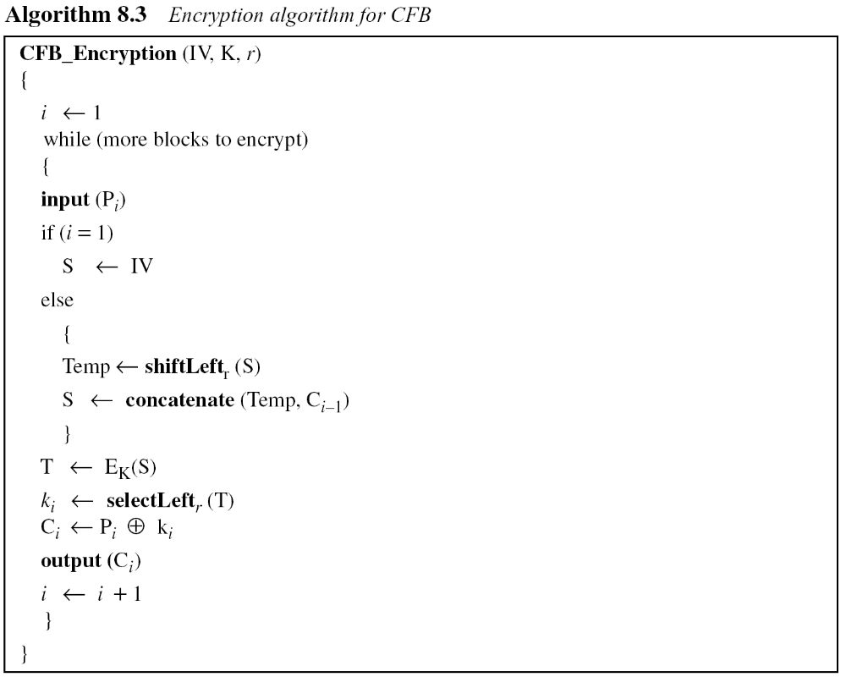
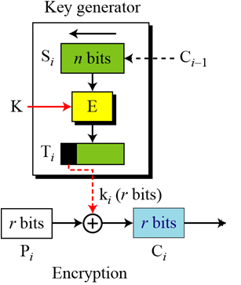
Pseudocode for CFB
B C Dhara, Dept. of IT, JU

Slide 28
Security issues
Block level pattern is not preserved
An attacker can add some ciphertext block at the end of ciphertext stream
B C Dhara, Dept. of IT, JU

Slide 29
Error propagation
A single bit error in ciphertext block Cj during transmission creates a single bit error (at the same position) in plaintext block Pj
As long as bits of Cj present in the shift register, most of the bits of the subsequent blocks are in error (with 50% probability)
B C Dhara, Dept. of IT, JU

Slide 30
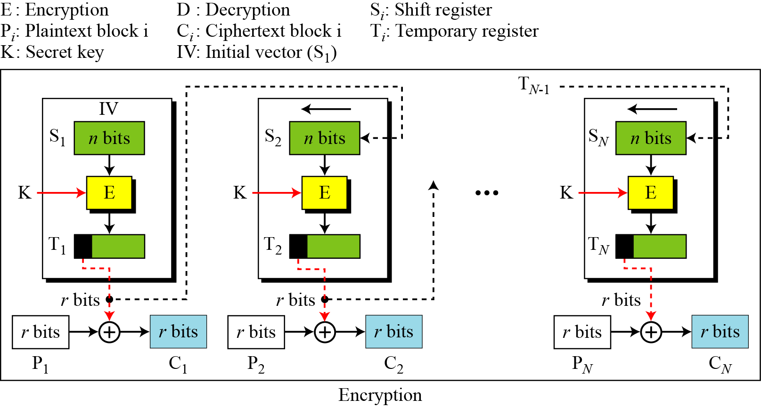
Output Feedback (OFB) Mode
It has some similarities to the CFB mode in that it permits encryption of differing block sizes
  It has the key difference that the output of the encryption block function is the feedback, instead of the ciphertext
  The XOR of each plaintext block is created independently of both the plaintext and ciphertext
  It is this mode that is used when there can be no tolerance for error propagation, as there are no chaining dependencies
  Like the ciphertext feedback mode, it uses an initialization vector (IV). Changing the IV in the same plaintext block results in different ciphertext
B C Dhara, Dept. of IT, JU

Slide 31
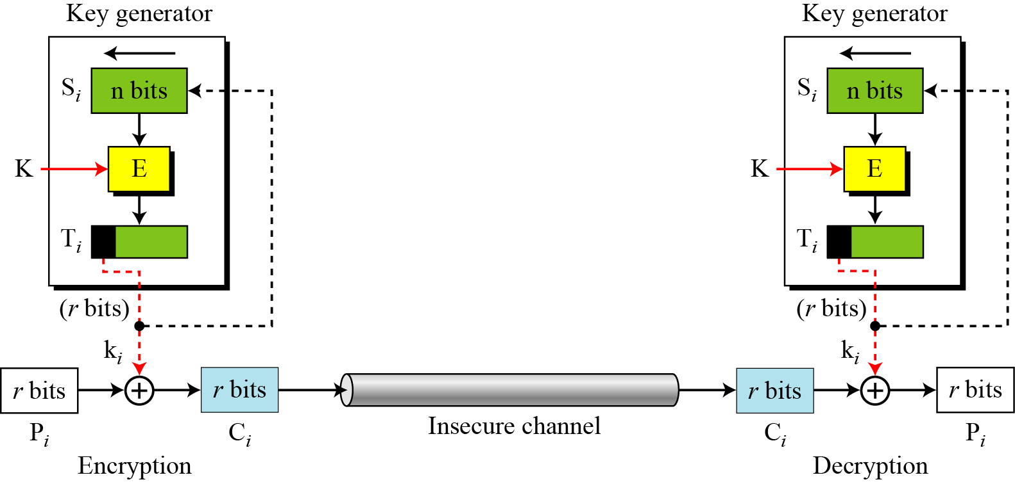
OFB as a Stream Cipher
This is synchronous stream cipher as key stream independent from plaintext and ciphertext
B C Dhara, Dept. of IT, JU

Slide 32
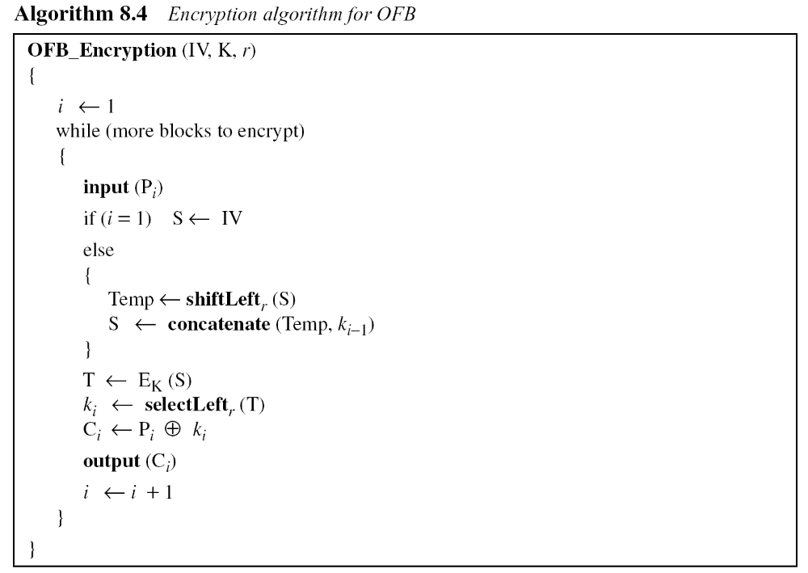
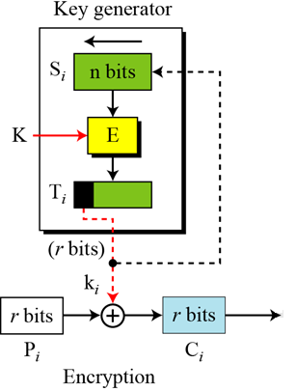
Pseudocode for OFB mode
B C Dhara, Dept. of IT, JU

Slide 33
Output Feedback (OFB) Mode (contd…)
Security issues:
  Patterns at the block level are not preserved
  Any change in the ciphertext affects the correspoing plaintext only
Error propagation:
  A single error in the ciphertext affects only the corresponding bit the plaintext
B C Dhara, Dept. of IT, JU

Slide 34
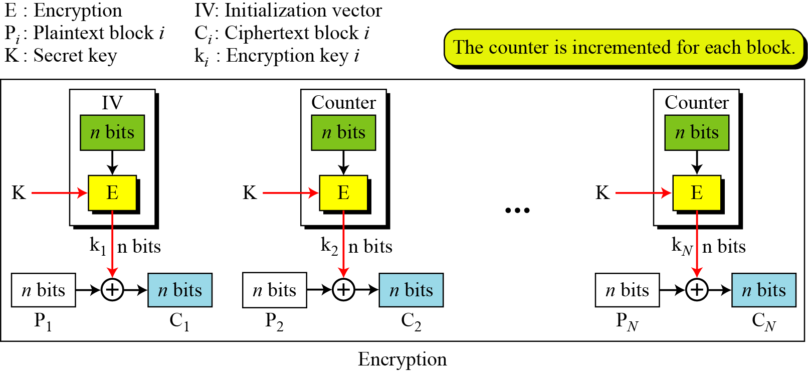
Counter (CTR) mode
In the counter (CTR) mode, there is no feedback
The pseudorandomness in the key stream is achieved using a counter
Counter is initialized to a pre-defined value IV and incremented based on some defined rule (mod 2^{n})
  For better randomness, the increment value can depend on the block number
B C Dhara, Dept. of IT, JU

Slide 35
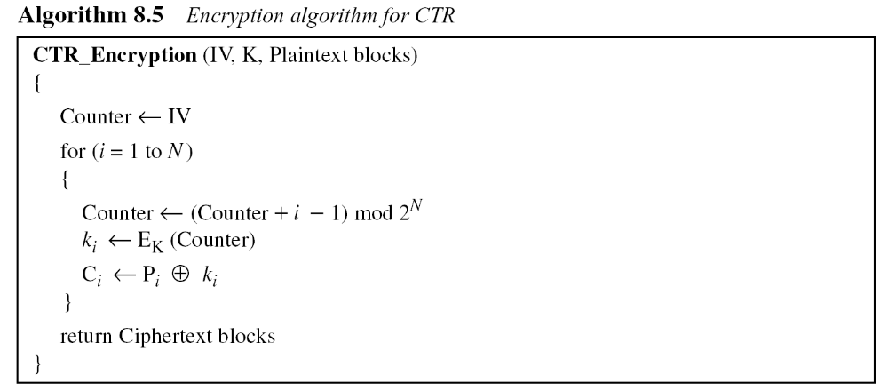
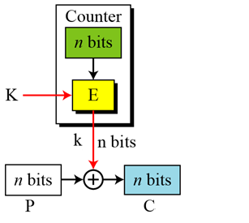
Pseudocode for CTR mode
B C Dhara, Dept. of IT, JU

Slide 36
Counter (CTR) mode (contd...)
Security issues:
  Same as that of OFB mode
Error propagation:
  A single error in the ciphertext affects only the corresponding bit in the plaintext
B C Dhara, Dept. of IT, JU

Slide 37
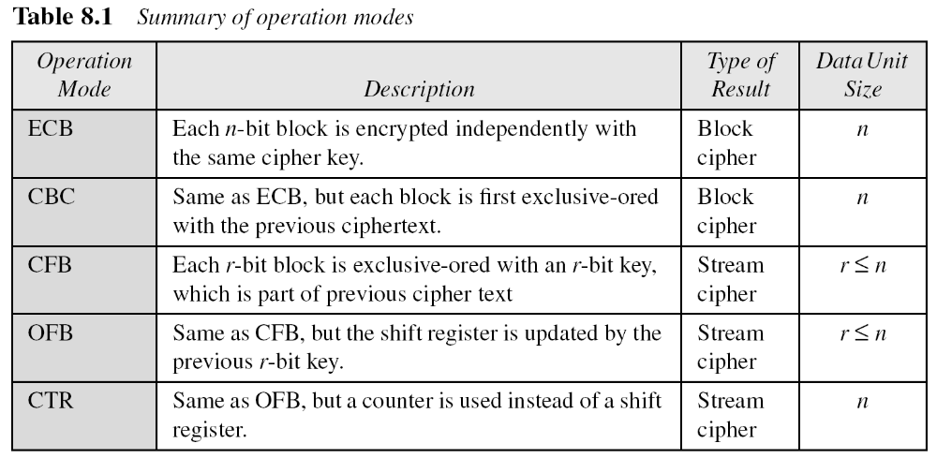
Comparison of Different Modes
B C Dhara, Dept. of IT, JU

Slide 38
Use of Stream Ciphers
Five modes of operations enable the use of block ciphers for encipherment of messages or files in large units and small units
Sometimes pure stream are needed for enciphering small units of data such as characters or bits
Stream ciphers are more efficient for real-time processing
We discuss two stream ciphers: RC4, A5/1
B C Dhara, Dept. of IT, JU

Slide 39
RC₄
RC4 is a byte-oriented stream cipher in which a byte (8 bits) of a plaintext is exclusive-ORed with a byte of key to produce a byte of a ciphertext
RC₄ is based on the concept of a state
  State is a byte, stored in an array S[0…255]
  Randomly one byte is selected to serve as the key for encryption
B C Dhara, Dept. of IT, JU

Slide 40
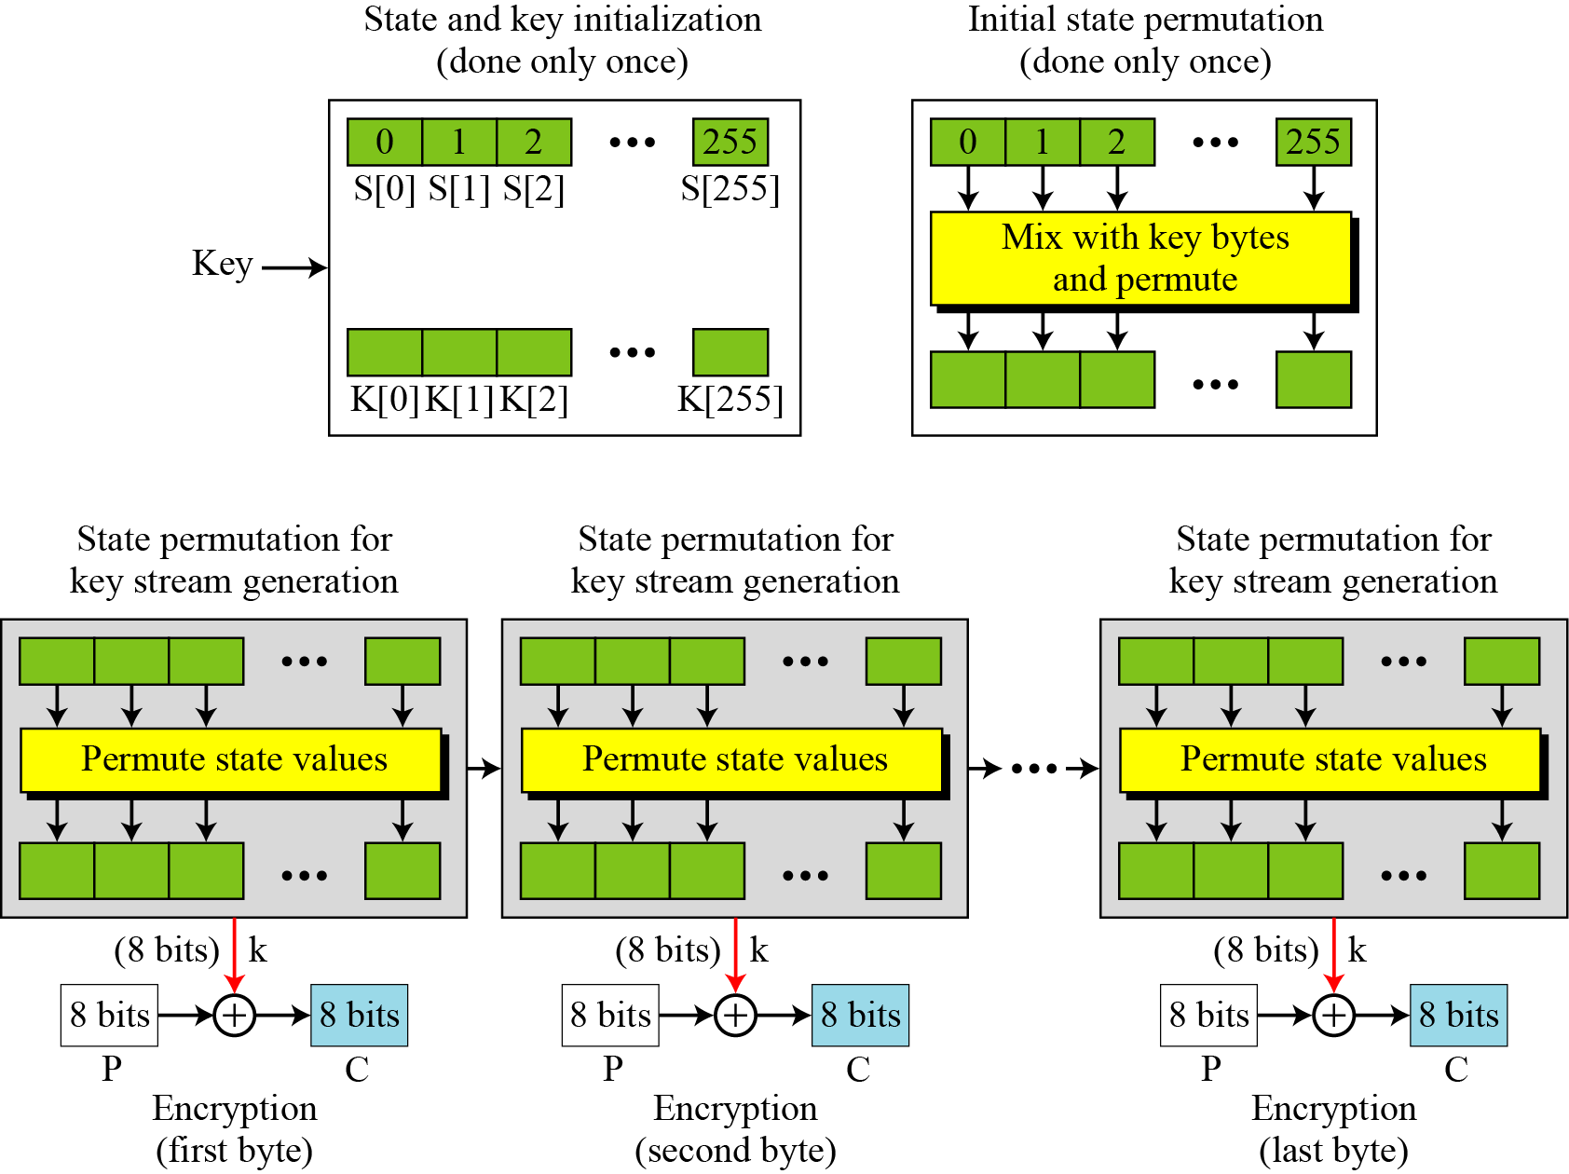
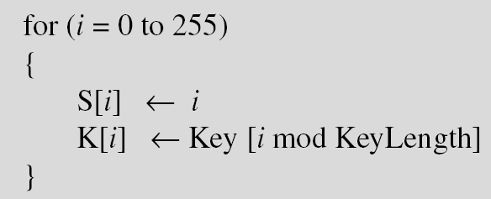
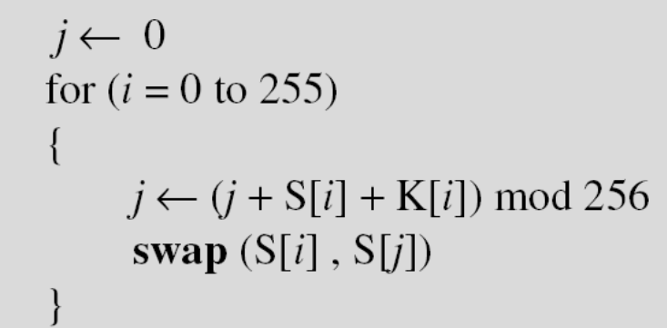
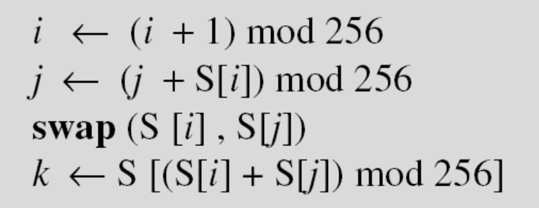
Idea of RC₄ stream cipher
‘Key’ may be a 5 - 16 byte
B C Dhara, Dept. of IT, JU

Slide 41
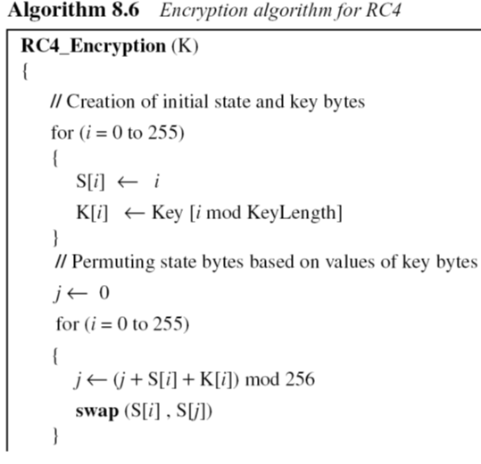
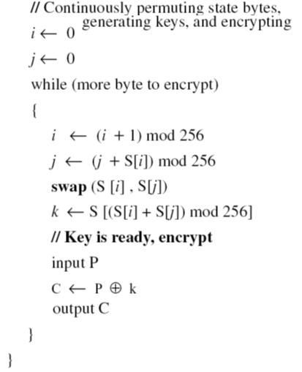
Pseudocode for RC₄
B C Dhara, Dept. of IT, JU

Slide 42
Randomness of key stream
A secret key with all bytes set to 0
The key stream for 20 values of k is (222, 24, 137, 65, 163, 55, 93, 58, 138, 6, 30, 103, 87, 110, 146, 109, 199, 26, 127, 163)
The secret key is of five bytes of (15, 202, 33, 6, 8)
The key stream for 20 values is (248, 184, 102, 54, 212, 237, 186, 133, 51, 238, 108, 106, 103, 214, 39, 242, 30, 34, 144, 49)
B C Dhara, Dept. of IT, JU

Slide 43
Security issues
Cipher is secure if key size is at least 128 bits
Some reported attacks for smaller key (size less than 5 bytes)
It is recommended that different keys should be used for different sessions
B C Dhara, Dept. of IT, JU

Slide 44
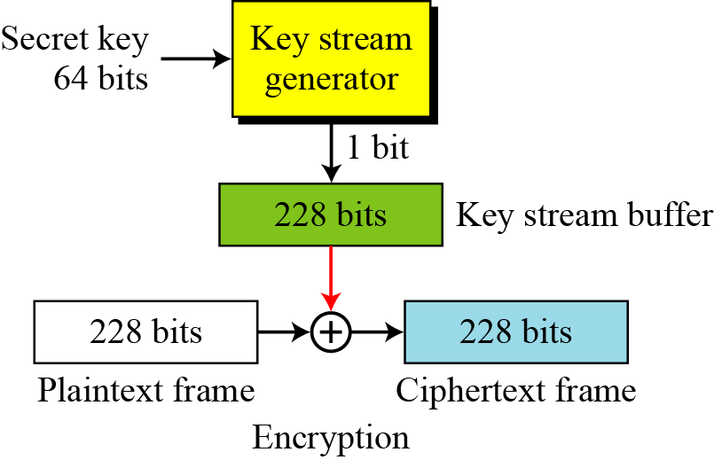
A5/1
A5/1 is a stream cipher which uses LFSR to generates bit stream
Key stream is generated using 64 bits
Key stream is stored in a 228-bit buffer and XOR-ed with a 228-bit stream
B C Dhara, Dept. of IT, JU

Slide 45
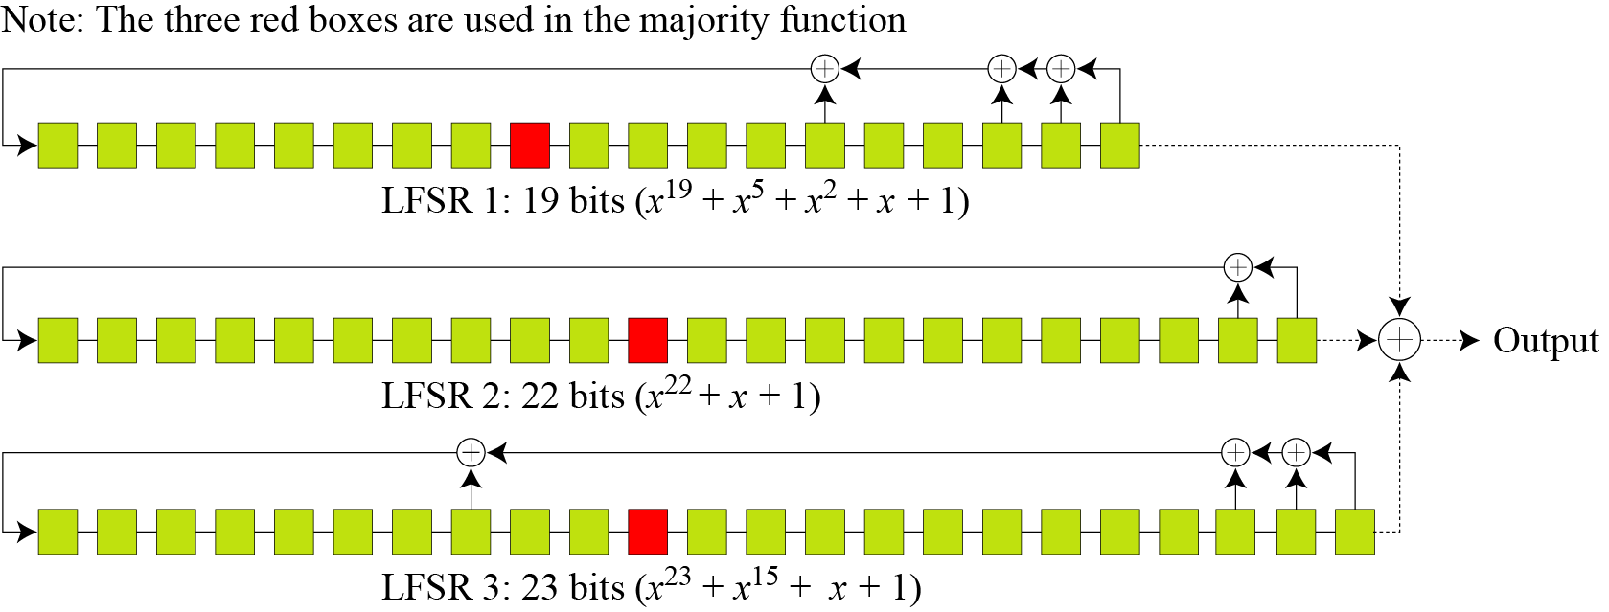
Key Generator
A5/1 uses three LFSRs with 19, 22, and 23 bits
Red one is the clock bit
B C Dhara, Dept. of IT, JU
x²³+x¹⁵+x²+x+1

Slide 46
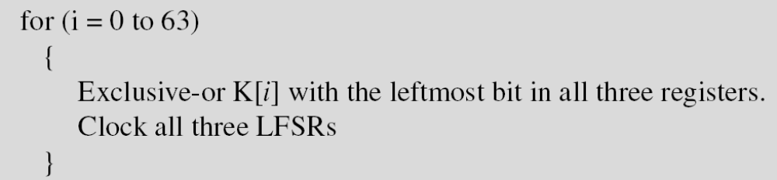
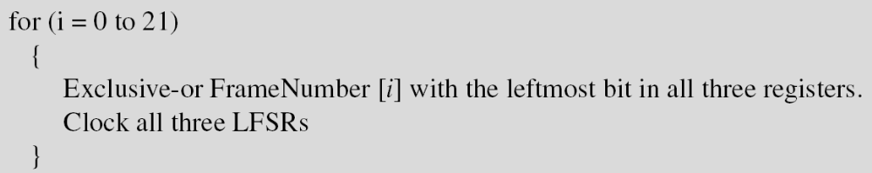
Key Generator (contd…)
Initialization: 64-bit secret key, 22 bit frame number are used
  set all bits in three LFSRs to 0
  Mixing with key value and clocking means shifting LFSR
  Mix with 22 bit frame number
B C Dhara, Dept. of IT, JU

Slide 47
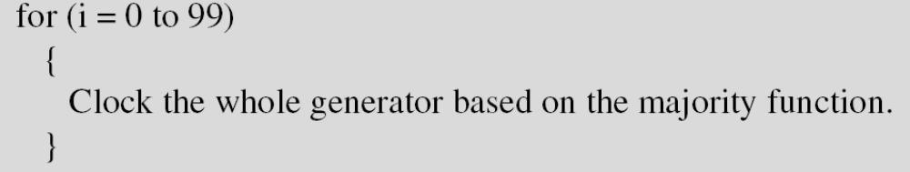
Key Generator (contd…)
  Clock key generator 100 cycle, using majority function
Key stream bits
  Key generator creates one bit in each click
  Input to the majority function are the clicking bits
  It clicking bit matched with output of majority function, the LFSR will be clocked; otherwise not
  At a time two or three LFSRs will be clocked
B C Dhara, Dept. of IT, JU

Slide 48
Example
At a point of time the clocking bits are 1, 0, and 1. Which LFSR is clocked (shifted)?
Solution
The result of Majority (1, 0, 1) = 1. LFSR1 and LAFS3 are shifted,
but LFSR2 is not.
B C Dhara, Dept. of IT, JU

Slide 49
Encryption/Decryption
The bit streams created from the key generator are buffered to form a 228-bit key
XOR-ed with the plaintext frame to create the ciphertext frame
Encryption/decryption is done one frame at a time.
B C Dhara, Dept. of IT, JU

Slide 50
Key management
Alice and Bob need to share a secret key between themselves to securely communicate using a symmetric-key cipher. If there are n entities in the community,
n(n − 1)/2 keys are needed
B C Dhara, Dept. of IT, JU

